Slide 1


How Continuous Ketone Monitoring can Augment an Automated Insulin Delivery System
Prof Ketan Dhatariya MBBS MSc MD MS FRCP PhD
Consultant in Diabetes and Endocrinology
Norfolk and Norwich University Hospitals
Honorary Professor of Medicine, University of East Anglia

Slide 2
Disclosures
In the last 12 months I have received honoraria, travel or fees for advisory boards from
  AstraZeneca
  Novo Nordisk
  Boehringer-Ingelheim
  Eli Lilly
  Abbott Diabetes

Slide 3
Back to Basics
At different plasma concentrations, insulin has different effects
  At the very lowest concentrations, insulin suppresses ketogenesis
  Then it stops gluconeogenesis and skeletal muscle catabolism
  Then it causes glucose uptake and glycogen synthesis
  Finally, it is an anabolic hormone
Barwell ND et al Br J Cardiol 2011;18(5/6):224-228

Slide 4
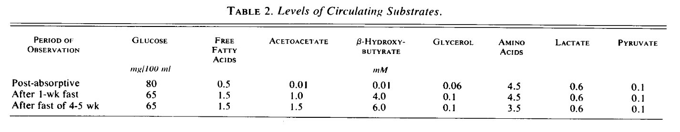
Ketones – Why Are They Important?
Evolution!
Cahill GF NEJM 1970;282(12):668-675
Cahill GF Diabetes 1971;20(12):785-799
Cahill GF Ann Rev Nutr 2006;26(1):1-22

Slide 5
Conditions in Which They are Raised
Diabetic ketoacidosis (with or without raised glucose)
Starvation
Pregnancy
Excess alcohol intake
SGLT2 inhibitor use
Their presence represent states of absolute or relative insulin insufficiency

Slide 6
Euglycaemic DKA?
Munro JF et al BMJ 1973;2(5866):578-5880
Kitabchi AE et al Diab Care 2009;32(7):1335-1343
Dhatariya K et al Diab Med 2016;33(2):252-260
Macfarlane J et al Mayo Clin Proc 2019;94(9):1909-1910

Slide 7
CGM Use and Risk of Hospitalizations
Roussel R et al Diabetes Care 2021;44(6):1368-1376

Slide 8
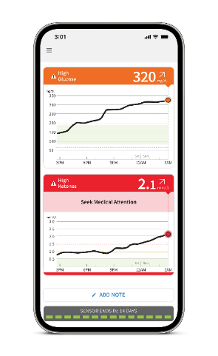



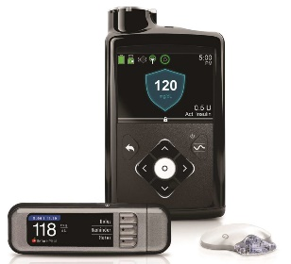

A Theoretical Example of an Integrated Continuous Glucose & Ketone Monitoring System With an AID
Warning – High Ketones Detected
SENSOR
MOBILE APP
CLOUD SOFTWARE
MOBILE DEVICE APP
AID SYSTEM
Continuously monitors glucose and ketone levels every minute without user calibration
10-14 days of data storage
Automatically displays glucose result (value, trend arrow and graph)
Optional, customizable glucose and ketone alarms
Cloud-based software
Glucose and ketone reports
Shared glucose and ketone alarms
Notes:
The caregiver app collects data passed from the app through the cloud, allowing the user to share glucose and ketone results and alarms with their care team.

Slide 9
Potentials
There are several!
  Helping to identify a rise in ketones allowing the implementation of Sick Day Rules
  Early warning of pump / infusion set failure
  Preventing acute illness / hospital admission
  High risk people may get most benefits – recurrent DKA, poor social circumstance, meal insecurity, homeless, etc
  Fewer pieces of ‘kit’ to carry about

Slide 10
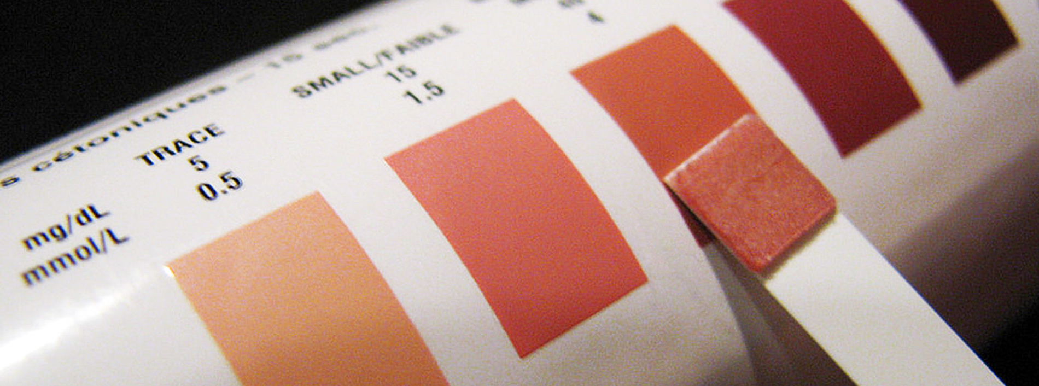
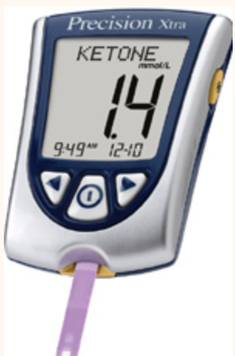
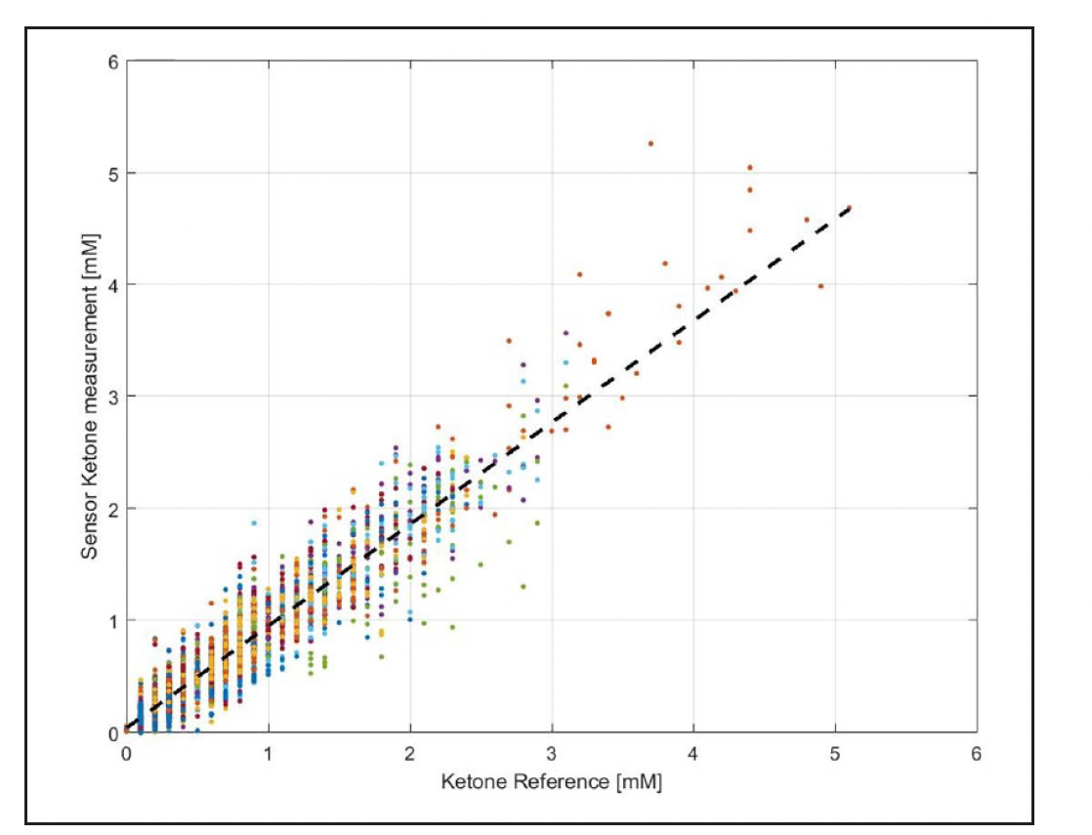
Challenges
There are several!
  Education of people with diabetes – what do the numbers mean?
  Education of health care professionals – what do the numbers mean?
  Do we need a Red / Amber / Green system rather than numbers?
  Calibration of the device – margin of error at high levels
  Developing an AID algorithm that incorporates ketones / sick day rules
  When does physiological become pathological?
  Are there significant differences between blood / capillary and interstitial fluid?
  T1DM vs T2DM
  How to manage euglycaemic ketonaemia/DKA
  Physiologically speaking, when does a child become an adult?
  Reimbursement?
Alva et al Journal of Diabetes Sci Technol 2021;15(4):768-774

Slide 11
In Summary
Ketones are an evolutionary adaptation to prolonged starvation
Their presence can be beneficial or harmful – depending on the rate of appearance in the circulation
Continuous ketone measurement seems to be the next logical step in the management of type 1 diabetes, and incorporation into an AID system seems likely
Challenges remain but the potential for benefit is huge

Slide 12

How Continuous Ketone Monitoring can Augment an Automated Insulin Delivery System
www.norfolkdiabetes.com
ketan.dhatariya@nnuh.nhs.uk
@ketandhatariya
@JBDSIP
@ABCDiab

